Slide 1
C# - Exception Handling
An exception is a problem that arises during the execution of a program. A C# exception is a response to an exceptional circumstance that arises while a program is running, such as an attempt to divide by zero.
Exceptions provide a way to transfer control from one part of a program to another. C# exception handling is built upon four keywords: try, catch, finally, and throw.
try − A try block identifies a block of code for which particular exceptions is activated. It is followed by one or more catch blocks.
catch − A program catches an exception with an exception handler at the place in a program where you want to handle the problem. The catch keyword indicates the catching of an exception.
finally − The finally block is used to execute a given set of statements, whether an exception is thrown or not thrown. For example, if you open a file, it must be closed whether an exception is raised or not.
throw − A program throws an exception when a problem shows up. This is done using a throw keyword.

Slide 2
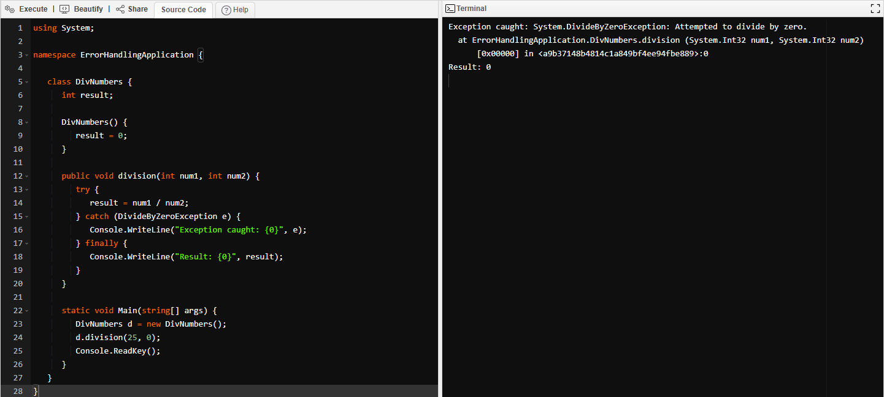
C# Code

